Slide 1

Legislative and environmental clearance procedure in India
Environmental Clearance Procedures in India

Slide 2
Project screening in India
Environmental Impact Assessment Notification 1994 issued under Environmental (Protection) Act 1986 has made EIA application mandatory for the construction of new projects and expansion and modernization of existing projects. The notification of 1994 listed 29 types (later it became 30) of projects (Schedule I) undergoing an EIA.
The central government is responsible for issuing the Environmental Clearance Certificate. The notification of 1994 and all its amendments have now been replaced by a comprehensive EIA notification issued in 2006.
Accordingly, the projects have been classified into ‘A’ and ‘B’ categories based on the severity of the impacts on the environment.
All new projects and expansion and modernization of existing projects are required to undergo an EIA. Application is submitted for obtaining Prior Environmental Clearance Certificate from the central government for ‘A’ category of projects (Schedule I) and from the state government for ‘B’ category of projects (schedule II).
The notification has further classified the ‘B’ category of projects into B1 and B2. The environmental authority of the state government screens and issues Environmental Clearance Certificate for B1 projects. However, for ‘B2’ category of projects, there is no need of Environmental Clearance Certificate.

Slide 3
There is no need of screening of projects under ‘A’ category. But, screening is required for projects under ‘B1’ category.
The application Form 1 (Refer test book for Form 1) should be duly filled out and submitted to State Environmental Impact Assessment Authority (SEIAA) and submitted to State level Expert Appraisal Committee (SEAC) for review.
Based on the recommendation of SEAC, SEIAA provides a decision of screening for determining whether or not the project or the activities require further environmental studies for preparation of the EIA report.
However, any project activities specified as ‘B’ will be treated as ‘A’ if the proposed project is located in whole or in part within a 10 km boundary of i) protected areas, ii ) critically polluted areas, iii) notified eco-sensitive areas, and iv) inter-state or international boundaries.

Slide 4
Project category ‘B’ has been divided into B1 and B2. B1 is subjected to environmental screening while B2 does not have to be screened.
The Ministry of Environment and Forestry of the Government of India issues notices from time to time for specifying B2 type of projects.
See Annex 3 (Refer book) for a list of the new projects or expansion and modernization of existing projects that require environmental consideration as per Schedule I of EIA Notification 2006.
For projects falling under ‘A’ category, Prior Environmental Clearance is obtained from MoEF, but for category B projects, Prior Environmental Clearance is obtained from State-level Environmental Impact Assessment Authority (SEIAA) before any construction works can begin.

Slide 5
Screening, scoping, and appraisal
Expert Appraisal Committee (EAC) of central government and State-level Expert Appraisal Committee (SEAC) of state government screen, scope and appraise the project. EAC and SEAC usually meet once every month.
EAC and SEAC are reconstituted after every 3 years; members of EAC or SEAC may inspect the site for screening/scoping/appraisal, but for this, applicants should receive a notice at least 7 days before the visit for inspection.
The chairman of State Level Environmental Impact Assessment Authority (SEIAA) settles the case. If this is not possible, the decision of the majority should prevail.

Slide 6
Application for Prior Environmental Clearance (PEC):
In the process of seeking PEC, the prescribed Form 1 or Form 1A should be filled out, but this has to be done before commencing construction activities.
Along with Form 1, the applicant should submit a pre-feasibility study report or a conceptual plan report for non-construction project.
Stages for PEC for new projects:
Stage (1): Screening (for B category projects): The project proponent should fill out Form 1 (Appendix 1 of Notification 2006) and State-level Environmental Appraisal Committee (SEAC) determines whether the project requires EIA for environment clearance. While project category B1 requires an EIA, project category B2 does not require one.

Slide 7
Stage (2): Scoping: Scoping is done by EAC for category ‘A’ projects, and by
SEAC in case of category ‘B’ projects, based on the information furnished in Form 1. Scoping is carried out to develop a comprehensive Terms of Reference (ToR) for the development of EIA report.
The EAC/SEAC can also review ToR submitted by the project proponent. EAC/SEAC can also visit the site if required.
Projects under category ‘B’ in Item (8) may not need scoping and may be examined based on Form 1/Form 1A or conceptual plan.
Within 60 days time of submission of Form 1, the proponent receives ToR.
For hydropower category A, Item 1 (c) of the Schedule, ToR is provided along with EC for pre-construction. If ToR is not available within 60 days, the proponent should consider that the ToR submitted by them is approved for EIA study.

Slide 8
The approved ToR will be published on the website of Ministry of Environment and Forest (MoEF). Application for Prior Environmental Clearance can be rejected by the authority based on the recommendation of EAC/SEAC at this stage also.
In such a case, the proponent should be informed within 60 days.
Stage (3): Public consultation: All category ‘A’ and ‘B’, projects require public consultation except improvement of irrigation project, Item 1 (c) (ii); project activities within the industrial estate or park, Item 7 (c); expansion of road and highways, Item 7 (f), which do not require further land; all building, area development, and township development projects, Item 8; and all category B2 projects and all defense related activities.

Slide 9
Public hearing should be carried out in the proximity of the project area based on Appendix IV and grievances should be obtained in writing.
These activities should be carried out by State-level Pollution Control Board (SPCB) or Union Territory Pollution Control Committee (UTPCC).
The proceedings of public hearing should be forwarded to the regulatory authorities within 45 days of the request from the applicant; if not, the regulatory authority engages other public institutions to hold public hearing within another 45 days.
If public hearing is not possible, the regulatory authorities should collect information from other reliable sources. The SPCB/UTPCC invite responses from stakeholders by placing summary of EIA report on their website within 7 days of request from applicant, or use other means of media to disseminate the information, or the authority receives a request to make the draft EIA report available.

Slide 10
In such cases, the draft EIA report is disclosed in a notified place during office hours till the date of public hearing. Any comments submitted will be forwarded to the applicant.
All the comments and suggestions are incorporated into final EIA and EMP reports and the final form of document is submitted to regulatory authority for appraisal.
Stage (4): Appraisal: EAC or SEAC examines EIA report, outcomes of public consultation, and hearing in a transparent manner; the applicant is invited to the meeting so that he/she can furnish necessary clarifications and EAC/SEAC can make recommendation to the authorizing agency to grant/reject the application for Prior Environmental Clearance.
The appraisal should be completed within 60 days of receipt of EIA report and other documents. Final decision might take another 15 days (Appendix V).

Slide 11
Grant or rejection of environmental clearance:
The regulating authority should provide its decision to the applicant within 45 days after receiving recommendation of EAC/SEAC, or 105 days after receiving EIA report.
Validity of Prior Environmental Clearance:
Validity of PEC is 10 years for river valley project, Item 1 (c), 30 years for mining projects, and 5 years for all other projects; however, it is decided by EAC/SEAC.
Monitoring programs are designed to determine the impacts of the proposed project.
A plan for the baseline and compliance monitoring to be implemented at different stages of project implementation is laid out.
Responsibility for monitoring is given to regional offices under the Water Act of 1974, the Air Act of 1981 and the Environmental Protection Act of 1986.

Slide 12
Prediction tools for EIA
Prediction of impacts: identifies and predicts impacts as quantitatively as possible in terms of characteristics such as magnitude, extent, and duration
Prediction should be based on the available environmental baseline data. Predictions can be described in quantitative or qualitative terms. They should, at the least:
1. Determine the initial reference of baseline conditions,
2. Estimate the future state if the proposed action is carried out,
3. Estimate the future state if the proposed action is not carried out.
Methods of impact prediction
There are many methods available for predicting the impacts on a variety of resources. A study conducted by ERL found that 150 impact prediction methods were utilized in just 140 EIA reports in the Netherlands and North America (VROM, 1980).
No prediction methods are perfect and more and more additional methods are being devised.

Slide 13
Predictive methods are extrapolative, meaning they use past and present data, trends and scenario analysis, analogies and intuition to arrive at a conclusion.
The normative method, in contrast, involves coming up with a set of desired targets for fulfillment.
Classification of Impact prediction methods
Mathematical models
Mathematical models are based on cause-effect relationships usually expressed in the form of mathematical functions. They include simple input output as well as complex dynamic models. They are primarily used to predict a partial impact, for example, phosphorus retention in a lake or the economic multiplier in a particular area.
Comprehensive and holistic mathematical models are rare except in some cases of land-use planning
a. Deterministic: models are usually derived through fixed relationships. They are commonly used to predict socio-economic impacts such as the economic multiplier after money is injected into the project area and the local economy response.

Slide 14
b. Stochastic: models are probabilistic: predictions depend upon the probability that a number of events will occur in a given area and time.
2. Statistical models
Statistical techniques such as regression and component analysis are sometimes used to indicate the relationship between the data and the test hypothesis.
Predictions of flood frequencies, for example, may use statistical models.
3. Geographic information system
Satellite images, physical maps and aerial photographs provide information on existing resources.
GIS techniques can be used to predict the impacts of a development project as they allow for analyzing the effects of project activities on the resources present in the project area.

Slide 15
4) Field and laboratory experimental methods: A field inventory carried out prior to project implementation provides baseline information about the resources present.
For example, a fish resource survey of the rivers indicated that a long-distance migratory fish is dominant.
The construction of a dam in the upstream part of the river might impede the upstream migration of fish for breeding. If this is indeed the impact of the project, the predicted result would be a decline in the fish population upstream of the dam.

Slide 16
Laboratory tests also provide some insight into the effects of certain development activities on resources. For example, the application of DDT in fields might inhibit the growth of crop seedlings of crops.
Laboratory simulation tests would determine what doses of DDT might inhibit growth and set limits for safe application.
5. Expert judgment
Expert judgments are based on the fact that an event which occurs due to the implementation of certain development activities in a particular location may be analogous to and therefore a good prediction of similar impacts which might take place in other locations with similar conditions due to the implementation of similar activities.
The actual experience of one place can be utilized to predict the likely experiences of other, similar places elsewhere where the environmental impacts are yet unknown. For example, many irrigation development projects produce salinisation effects.

Slide 17
Constructing another irrigation project in a similar way in a similar environment is also likely to result in salinisation. Decisions about anticipated impacts which are based on past experience are referred to as expert judgments.

Slide 18
Assessment of Impact on air, water, soil, noise, biological and Socio cultural environment
Assessment of impacts on the air environment
To evaluate the impacts on air environment by any project activity, a six- step or six-activity model Figure was proposed for planning and assessment of impact studies.
The Six Main Steps in the Proposed Model for EIA Study on Air Environment are
I. Evaluation and identification of sources and quantity of air pollutant emissions of different phases of the proposed activity like the construction operation and development:
2. Detailed evaluation of the project area for the existing ambient air quality. emission inventory, and meteorological data;
3. Examination of appropriate laws. regulations, or criteria to be followed for maintaining ambient air quality and or pollutant emission standards;

Slide 19
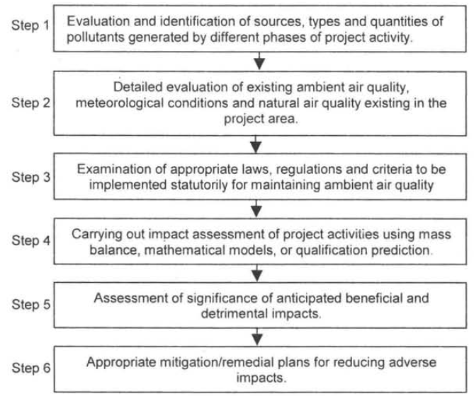
Six- Activity step model for EIA studies.
Courtesy: Environmental impact assessment methodologies Y. Anjayenelu and Valli Manickam

Slide 20
4. Carrying out impact assessment studies adopting mass balances, dispersion calculations. comprehensive mathematical models. and! or qualitative predictions based on case studies and professional judgment;
5. Assessment of significance of anticipated beneficial and detrimental impacts; and
6. Development of appropriate mitigation remediation measures for the adverse impacts.
Figure presents the relationship between the six main steps or activities in the proposed model which can be used to plan study focused on air quality impacts, to develop the scope of work for such a study. and / or review air quality impact information.

Slide 21
Step 1 : Evaluation arid Identification of Sources, Types and Quantities of Pollutants Generated by different Phases of Project Activity
Need to examine what types of air pollutants are likely to be emitted during the construction and / or operational phases of the proposed project - activity, and their quantities.
One can use the emission factor information based on the project type or activity. An "emission factor" is the average rate at which a pollutant is released into the atmosphere as a result of some activity, such as, combustion or industrial production, divided by the level of that activity. Emission factors relate to the types and qualities of pollutants emitted to indicators, such as, production capacity, quality of fuel burned, or vehicle-miles traveled by an automobile.

Slide 22
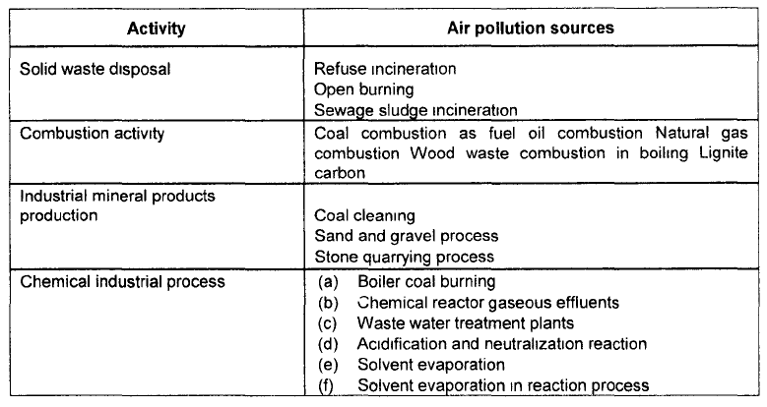
Air pollution sources of certain activities
Courtesy: Environmental impact assessment methodologies Y. Anjayenelu and Valli Manickam

Slide 23
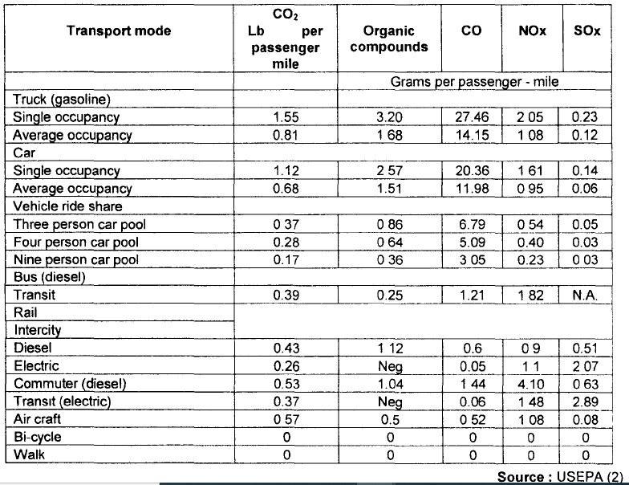

Slide 24
Some Typical Pollutants Released through Automobiles and their Inventory
Particulates
Lead (Pb)
Aldeydes
Secondary pollutants
Compilation of Air Quality Information and Procurement or Development of Emission Inventory

Slide 25
Step 2 : Detailed Evaluation of Existing Ambient Air Quality, Meteorological Conditions and Natural Air Quality Existing in the Project Area
Key Meteorological Data
Categorization of meteorological parameters. which hinder dispersion of pollutants emitted into the atmosphere have to be made on the following lines:
(a) Meteorological data which describe the general air-pollution-dispersion
characteristics of the study area.
(b) Meteorological data useful to describe the atmospheric dispersion of air pollutants form a project activity quantitatively.
(c) Meteorological data useful and necessary for air pollution dispersion modeling.

Slide 26
Baseline monitoring
To establish the concentration of specific pollutants in ambient air monitoring has to be carried out to verify the experienced changes in air quality concentrations for those pollutants which have been identified as potential problem, in the earlier steps.
Step 3 : Examination of Appropriate Air Quality Emission Regulation Laws and Air Quality Standards to be Maintained as Per Local, Stat and Central Government Notifications.
The basic information on air quality standards. criteria. and policies of Local. State and Central Government agencies which have the statutory authority to maintain the air resources has to be collected.

Slide 27
Documentation of this information will allow the determination of the significance of air quality impacts incurred during projects or activities and will aid in deciding between alternative actions or in assessing the need for mitigation measures for a given alternative.
Specific air quality management policies or requirements may be in existence for particular areas and the particular requirements of such policies have to be ascertained.
Step 4 : Carrying out Impact Assessment using Mass Balance Mathematics Modeling and Single Qualitative Approach
There are basically three aspects of air quality problems that are amenable to quantitative prediction. In order of increasing complexity. they are:
1. estimating rates of release of pollutants;
2. predicting atmospheric concentrations of pollutants; and
3. predicting deposition rates of pollutants on soil. water. and vegetation

Slide 28
Impact prediction can be carried out using various approaches like mass balances, ambient air dispersion models. and plume dispersion models.
The areas likely to recover impacts of various pollutants from the various project activity sources should be assessed.
Predictions of concentrations and deposition rates are often needed as inputs into other predictive models to determine the potential for secondary and higher order impacts.
Step 5 : Assessment of Significance of Impacts
Evaluation of the significance of anticipated changes related to the proposed project should be carried out through conducting public meetings and/or public participation programs.
Professional judgement based on the percentage changes from baseline conditions in terms of air-pollutant emissions levels and/or exposed human population, or the PSI, should carried out.

Slide 29
These changes should also be considered during both the construction and operational phases of a project.
For certain type of projects or air-pollutant prediction methods, there are numerical standards or criteria which can be used as a basis of interpretation.
A final impact significance can be assessed based on the specific effects of the types of air pollutants from a proposed project or activity and identification of sensitive receptors in the study area.

Slide 30
Step 6 : Development of Appropriate Mitigation or Remediation Plans for Reducing Adverse Impacts
Remediation or mitigation measures for reducing the adverse impacts involve project activity design or operational features that can be used to minimize the magnitude of the air quality impacts.
Mainly the design should be revised as needed in order to reduce the air pollutants expected to be omitted from the project-activity.
The revised project or activity can then be reassessed to determine whether other remediation or mitigation measures will help in eliminating or minimizing the deleterious air quality impacts.

Slide 31
Assessment of Impacts on Soil and Ground Water Environment
The integrity of soils and groundwater can be altered by a variety of physical disturbances, including the addition/removal of soil and/or water, compaction of soil, changes in use of land or ground cover, changes in water hydrology, changes in climate (temperature, rainfall, wind) and the addition or removal of substances or heat (for example. discharge of effluents into groundwater, discharge of effluents or disposal of waste onto land leaching of contaminants into groundwater, changes in quality of surface water, and deposition of air pollutants on land).
The effects of these vary from first order effects of leaching into soil and groundwater to changes in groundwater regime. soil structure (including erosion and subsidence), soil quality or temperature, and ground water quality or temperature.

Slide 32
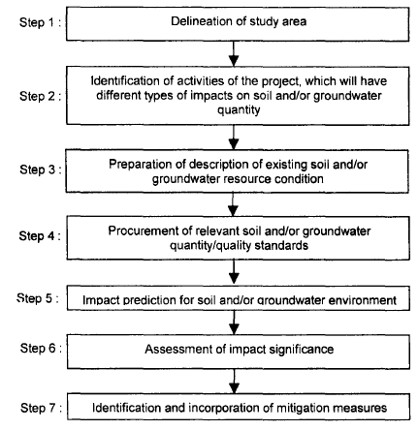
Systematic approach for the study of impacts on soil and ground water
Courtesy: Environmental impact assessment methodologies Y. Anjayenelu and Valli Manickam

Slide 33
Delineation of Study Area
Very specific based on presence of potential impacts. The study area should reflect the full reach of possible effects within the particular impact discipline that is being considered.
The proposed or future land-use map along with committed land-use policies, zoning, and development projects should be included in the study area.
The map should clearly distinguish between developed and undeveloped land. Categories shown on land-use map, should be
- Residential
- Commercial and industrial
- Institutional and parks or recreation
- Non-urban mixed
The map could include further divisions, such as separate commercial and industrial activity centers and public vacant lands

Slide 34
2. Identification of Activities, Which Will Have Different Types of Impacts on Soil and/or Groundwater Quantity – Quality
Direct Land-Use Impacts on Land
Land forms and Soil profile
Soil composition and Slope stability
Seismicity and Subsidence and compaction
Flood plains Swamps and Land use
Mineral or engineering resources and Buffer zones

Slide 35
3. Description of Existing Soil and/or Ground water Resources Soil Characteristics
Background Information on the Soil Environment
1. Soil Characteristics: Soil characteristics in a given geographical area at a given point of time are a function of both natural influences and human activities. The soil and geological environments are typically associated with the physical and chemical environment.
For example, the habitat types and associated vegetation found in an area will be a function of the soil characteristics.
Additionally, cultural resources may be related to soil characteristics or possibly, to unique geological features in an area.
The relationship between shallow, alluvial aquifers and the flow of surface streams and rivers may need to be explored.

Slide 36
2. Unique Soil or Groundwater Problems
Many geographical areas exhibit special or unique problems that should be addressed in the description of baseline conditions for the soil or groundwater resources in the study area.
Examples of these problems include saline seeps, groundwater supplies relative to existing bacteriological or other quality constituents, poor natural quality, and the presence of hazardous waste sites.
Dryland farming practices involving irrigation often lead to salt accumulation in surface soils and shallow unconfined aquifers.

Slide 37
3. Pollution Sources and Groundwater Users
It is appropriate to consider which other potential and actual sources of soil and/or groundwater pollution may exist in the study area, and also to consider current and potential future usage of the groundwater resource for purposes of water supply techniques.
Quantitative impact prediction is typically associated with the use of look - alike, or analogous projects for which knowledge and information are available, and/or the utilization of relevant case studies.

Slide 38
4. Procurement of Relevant Soil and/ or Groundwater quantity /quality Standards
Land-use restrictions, soil quality standards, soil reclamation requirements, and groundwater quantity - quality standards, regulations, or policies are examples of institutional measures, which can be used to determine impact significance and required mitigation measures.
Thus, to determine the specific requirements for a given project area will require contacting appropriate governmental agencies with jurisdiction

Slide 39
5. Impact Prediction
The prediction of the impacts of a project - activity on the soil and/or ground – water environment(s), or conversely, the potential influence of the environment(s) on a proposed project, can be approached from three perspectives.
1. Qualitative
2. Simple quantitative, and
3. Specific quantitative
In general, efforts should be made to quantify the anticipated impacts; however, in many cases this will be impossible and reliance must be given to qualitative trend and through the spreading of excess sub-soil over the right - of - way during clean-up.
In general, the mixing of sub-soil with topsoil will have an adverse impact in soil fertility and soil structure.
The severity of the impact will depend on the nature of the sub-soil.

Slide 40
6. Assessment of Impact Significance
Environmental Analysis
The environmental analysis should yield the best possible prediction of environmental effects based on available information.
The conclusions of the analysis of potential induced development may be that the proposed project or action will
- Definitely cause and promote increased density of land use,
- Not cause any increase in development over what would occur in the future without the project,
- Not necessarily cause increased development, but perhaps accelerate development slated to occur anyway, and
- Not produce a development impact if local plans and policies stay unchanged, but indeed put into place the incentive for local planning bodies to change local comprehensive plans to permit higher-density land- use.

Slide 41
2. Other Secondary Effects
Many of these secondary impacts are not limited to socio-economic effects, but can equally affect natural resources, such as, water quality or wildlife habitat.
Increased covering of the earth with impervious surface, such as parking lots or large buildings, can increase the rate and pollutant loading of surface water run-off.
Secondary effects of such use can be the increased contamination of both surface water and groundwater resources.
A secondary effect may then be the need to construct additional water treatment plants with associated secondary effects of the use of limited public funds.

Slide 42
3. Assessment Impacts of Induced Development
These types of possible impacts could be called secondary impacts or impacts twice removed.
If induced development is predicted, the environmental impact analysis should consider, to the extent possible, the effects of this induced development.
Perhaps increased density of residential or commercial and industrial land use will, in turn create a need for additional schools, parks, public support programs and facilities, service industries, public water or power supply, solid waste and sewage disposal capacity, improvement in local roads or intersections, or increased emergency services (fire and police) and health care facilities.
Land development, resource extraction and waste - disposal projects can cause certain undesirable impacts on soil and/or ground- water resources (either quantity or quality changes).

Slide 43
7. Identification and Incorporation of Mitigation Measures
Mitigation Measures to Prevent Soil Erosion, Compaction and Ground Water Pollution During and After Execution of Any Developmental Project.
1. Use of techniques to decrease soil erosion during either the construction or operational phase of the project.
2. Where possible gentle gradients should be treated and steep slopes avoided.
3. Suitable drainage systems to direct water ways from slopes should be installed
4. Creating large open expanses of bare soil should be avoided
5. If the development is near to a water body siltation traps may need to be installed to trap sediment and prevent any damage to the fresh water ecosystem
6. Driving over the soil should be avoided or use wide tyres to spread the weight of vehicles thereby avoiding compaction
7. Few tracks too should bring vehicles to the working area

Slide 44
Assessment of Impacts of Noise on the environment
Noise is defined as any sound independent of loudness that can produce an undesirable psychological effect in an individual or a group.
Thus noise is an unwanted sound energy and is also considered as a pollutant when it exceeds certain limits. Noise has a short residence and decay time and hence does not remain in the environment for long periods like air or water pollutants.
By the time the average individual is spurred to action to reduce, or control, or at least, complain about sporadic environmental noise, the noise may no longer exist, either to notice or to measure.
In scientific terms, noise or sound is a pressure oscillation in the air or water or any medium, which conducts and travels (radiates) away from the source.
If noise can be controlled at the source, there is a saving in energy and energy costs, which will have an impact on production and production costs.

Slide 45
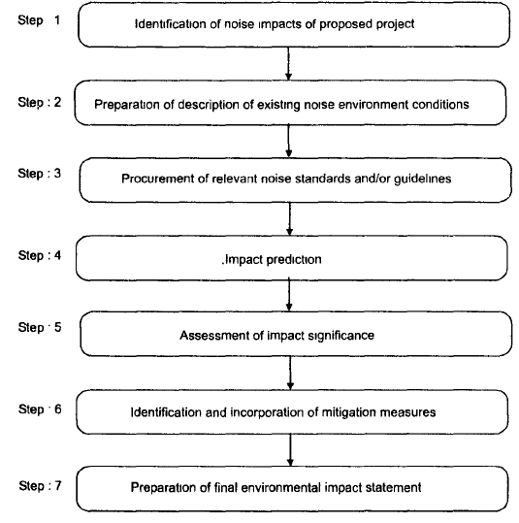
Systematic Methodology for Assessing Environmental Impacts of Noise
EIA Methodology for Noise Impacts
Conceptual approach for study focused on noise-environment impacts
Courtesy: Environmental impact assessment methodologies Y. Anjayenelu and Valli Manickam

Slide 46
Identification of Noise Impacts : The first step in the methodology is to determine the potential impacts of the proposed project (or activity) on the noise environment.
This requires the identification of the noise levels associated with the project. A considerable body of information exists on noise levels associated with a variety of projects and related activities.
The sources, of noise are numerous, so they may be broadly classified into two classes, namely, industrial and non-industrial. The industrial category may include noises from various industries like transportation, vehicular movements, rockets, defense equipment and
explosions.
Among the non-industrial category, the notable sources of noise are loudspeakers, traffic, air crafts, trains. construction works, radios, TVs, vacuum cleaners, mixers, power lawn movers and air conditioners in the domestic or commercial use.

Slide 47
2: Description of Existing Noise-Environment Conditions:
In analyzing the potential noise impacts of a proposed project (or activity), it is necessary to consider the study as area (potential project area or region of influence) associated with the noise emissions.
The delineation of a study area can be made based upon the boundaries of the land associated with the project. or the delineation can include a larger area by considering the area of noise influence within the vicinity of the proposed project.
The primary information which should be accumulated in this step is data on existing noise levels and noise sources within the study area. Land-use and human-population-distribution maps in relation to the proposed project would also be needed.
If no specific data on existing noise levels is available for the study area. it might be possible to use published noise-level information developed for project involving similar land use.

Slide 48
Step 3 : Procurement of Relevant Noise Standards and/or Guidelines
The primary sources of information on noise standards, criteria, and policies will be the relevant local, state, and federal agencies, which have a mandate for overseeing the noise environment of the study area.
Additional information may be available from international agencies such as the World Health Organization (WHO) or the United Nations‘ Environment Program.
This information can be used to determine the baseline quality and the significance of noise impacts incurred during projects (or activities); it could also aid in deciding between alternative actions or in assessing the need for mitigation measures for a given alternative.
1. General Noise Criteria, 2. Noise Emissions Standards

Slide 49
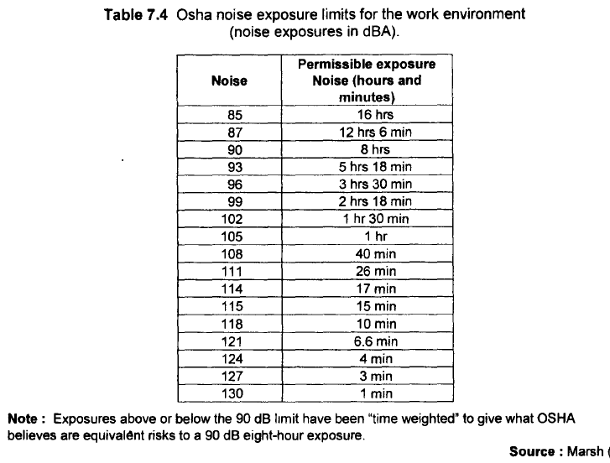

Slide 50
Step 4: Impact Prediction
Involves predicting the propagation of noise from a source and determining the type of affected land- use.
One method of expressing both existing noise and predicted noise levels is by using a level- weighted population value .
A sound-level-weighted population is a single number representation of the significance of a noise environment to the exposed population.
The assumptions are that the intensity of human response is one of several consequences of
average sound level, depending upon the response mode of interest (annoyance. Speech interference and hearing loss) and that the impact of high noise levels on a small number of people is equivalent to the impact of lower noise levels on a larger number of people in an overall evaluation.
Based on these assumptions. the "fractional impact" can be determined as the product of a sound-level-weighting value and the number of persons exposed to a specified sound level.

Slide 51
The sound-level-weighted population (LWP) is:
LWP = P(L_{dn})× W(L_{dn}) × d(L_{dn})
Where: P(L_{dn}) is the population distribution function,
W(L_{dn}) is the day-night average sound-level-weighting function characterizing the severity of the impact as a function of sound level
d(L_{dn}) is the differential change in day night average sound level.
A Noise Impact index (NII) can then be used for comparing the relative impact of one noise environment with that of another. It is defined as the sound-level-weighted population L WP divided by the total population (P_{total}) under consideration:
NII = LWP / P_{total}

Slide 52
Forecasting noise levels
Forecasting methods include equations, computer models. and physical models.
The simplest are equations, which estimate noise from information on traffic flow, composition, and speed.
Computer models are perhaps more widely employed and can be used to forecast future changes in baseline condition and the likely actually autonomous and difficult to integrate into the surrounding social environment.
Prediction of Traffic Noise Levels
The methodology developed under National Cooperative Highway research program of USA is a widely adaptable methodology for the prediction of highway noise as it is very simple with a high success rate.
The first step is known as a short method in which a gross quick and gross prediction of the noise levels will be made.
The second step of methodology is termed as NCHRP 174 "complete method" which utilizes-a fairly large computer program to refine the predictions made in the first step. The third step in this procedure is termed as "selection of a noise control design". The fourth step is termed as "check the design operation" in which the second step will be repeated and refined to arrive at the final conclusions.

Slide 53
Computer models:
STAMINA, Noisecalc, Jica Noise model.
5. Assessment of Impact Significance
One basis for evaluation of significant impact is public input; this input could be received through a continued scoping process of the conduction of public meetings or public participation programs or both.
The general public can often delineate important environmental resources and values for particular areas. and this should be considered in impact assessment.
Professional judgment can also be useful to assess the percentage changes from baseline conditions in terms of noise levels and/or exposed human population, or a noise index

Slide 54
6. Mitigation Measures
Mitigation measures refer to steps that can be taken to minimize the magnitude of the detrimental noise impacts.
The key approach to mitigation is to reduce or control the noise expected to be emitted from the project (or activity).
Mitigation can proceed along three possible courses of action, either by changing 1. the source of noise, 2. the path of noise from the source to the receiver, or 3. the receiver of noise.
Some additional principles of noise control include the reduction of the number. of vibrating sources, enclosure of the source, and attenuation of noise by absorbing barriers methods.

Slide 55
Simple hand calculations and/or computer models described earlier can assist in forecasting the relative effectiveness of various designed and/or operational phase mitigation techniques.
Further, various designs can be used to reduce the noise from specific sources; for example, the mechanical noise from the gearbox of large wind turbines can be minimized by adapting specific design features.

Slide 56
7: Prediction of Final Impact Statement
The final environment impact statement should include summary tables and discussion with industries.
The results of analysis will help in decision making. Maps should show location of surface receptors and measurement rates and size balance.

Slide 57
Assessment of Impacts on biological environment
1. General:
The nature of the proposed development and its likely impacts, the size of the impact area, the time and resources available for investigation, and the degree to which environmental systems are being investigated, are the major concerns of an ecological assessment.
A desk study and site visit undertaken during the scoping exercise provides assessments of four key areas:
1. Areas likely to be affected both directly and indirectly,
2. Potential factors leading to the impacts,
3. Species, groups, habitats, and communities of concern to the EIA, and
4. Methods of field investigation

Slide 58
A habitat survey provides a general description of the habitat and vegetation types within a study area.
2. Sources of existing information
A habitat survey aims to make maximum use of existing information.
A desk study is initiated at the scoping stage in order to identify baseline conditions.
1. Maps
A good historical record can provide valuable information about a site. Historical information about that site may be available from maps found in various libraries. Survey maps provide information on local topography, the location of forestland, and types of vegetation
2. Published literature
Some information on plant and animal species and their distribution can be obtained from the Natural History Museum/university departments. Further sources of information on the distributions, habitat requirements, and conservation status (rare, protected, endangered, etc.) of certain species can be obtained from Worldwide Fund for Nature (WWF), the World Conservation Union (IUCN), and universities.

Slide 59
Field surveys
It is essential that ecological fieldwork is conducted and closely supervised by an experienced ecologist who understands the principles and problems of sampling and is competent in identifying species.
3. Vegetation
Assessments of flora should include all vascular plants, bryophytes, thallophytes, lichens, algae, and fungi.
The major vascular plants about which information must be collected include: a) plants with forestry value, b) plants with medicinal value, and c) plants with agricultural or food value.
It is essential to employ experts who are competent in the identification of the various groups and have some knowledge of their ecology.

Slide 60
The five important decisions to be made in planning a detailed field survey are listed below:
(a) sample size,
(b) sampling pattern,
(c) species abundance,
(d) relevant environmental factors, and
(e) methods of data analysis.
Number of individuals: Numbers are usually counted in quadrates and expressed as the density (number per unit area) or population size (total number in site or overall study area).
Coverage: This is the percentage of the total area occupied by a perpendicular projection of the aerial parts of a particular species.
Frequency: This is the percentage of observations in a sample that contains a particular species.

Slide 61
4. Wildlife
Terrestrial communities
In general, it is more difficult to sample animals than plants because while plants
are stationary, animals generally move.
For this reason, few EIAs attempt a quantitative study of animals. Instead, they contain lists of the mammals, reptiles, birds, butterflies, and other insects present in the project area and of their habitats, seasonal movements and conservation status (rare, endangered, etc.).
The ecological value of a site can be determined largely from the vegetation study because most resident and visiting animals depend on vegetation for food and shelter.
However, other factors such as climate also affect their distribution and animals themselves can influence plant communities.

Slide 62
Rare, endangered, protected, threatened, and endemic species of wildlife are often detectable only if a systematic faunal survey is carried out. The Convention on International Trade in Endangered Species (CITES) and the IUCN’s Red
Data Book have developed criteria for establishing the category of threat for different species.
The fauna present in any area of impact is usually diverse and often extremely abundant, so a faunal survey can be daunting.
However, compiling a list of the animal species found is a requisite for habitat surveys. A detailed study of animal populations is likely to be undertaken only in exceptional cases and even then, study of all the animal communities present is not practicable.

Slide 63
References
Ram B. Khadka, Steve Gorzula, Ananda R. Joshi, Shailendra Guragain, and Ajay B. Mathema. “Environmental Impact Assessment, Processes, Methods, and practices of South Asia (Bangladesh, Bhutan, India, and Nepal)”, 1 st Edition, 2013, School of Environmental Science and Management and Institute of Environment and Development: Research and Capacity Building Initiatives, Nepal.
Y. Anjaneyulu and Valli Manickam. “ Environmental Impact Assessment Methodologies, Second edition, 2007, BS Publications, India.
Peter Morris and Riki Therivel. Methods of Environmental Impact Assessment, Second edition, 2001, Spoon Press, London.
Asit K. Biswas and S. B. C. Agarwal. “ Environmental Impact Assessment for Developing Countries, 1992, Butterworth-Heinemann Ltd, Oxford.

